Slide 1
Transformation Background
What is Transformation ?

Slide 2
What is a Transformation
Transformation:
An operation that changes one configuration into another
For images, shapes, etc.
A geometric transformation maps positions that define the object to other positions
Linear transformation means the transformation is defined by a linear function... which is what matrices are good for.

Slide 3
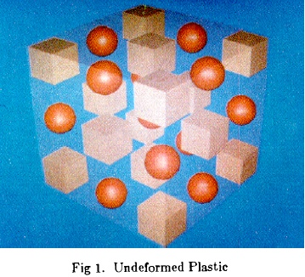
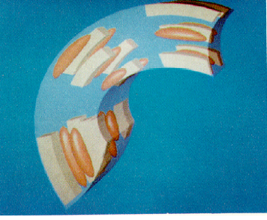

What is a Transformation?
A function that maps points x to points x':
Applications: animation, deformation, viewing, projection, real-time shadows, …

Slide 4
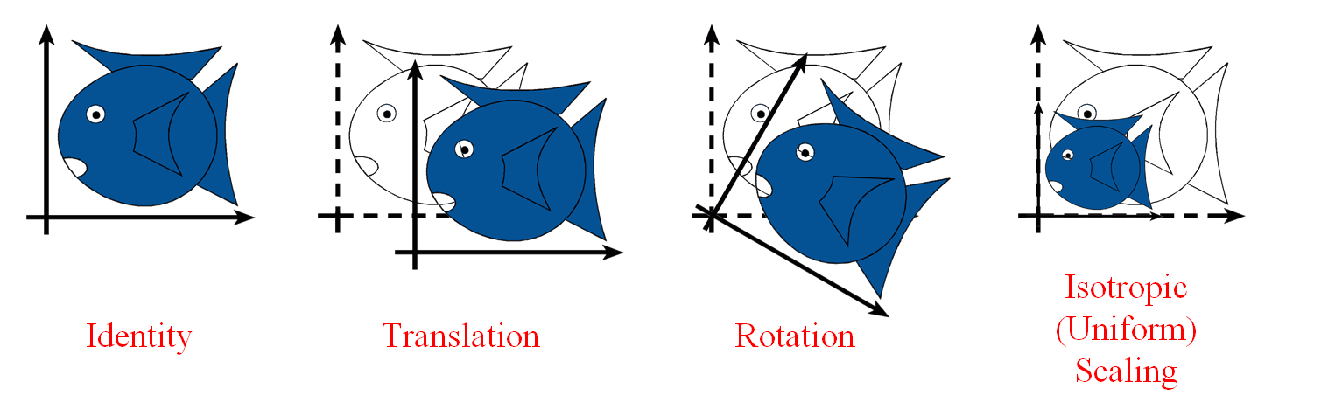
Simple Transformations
Can be combined
Are these operations invertible?
Yes, except scale = 0

Slide 5
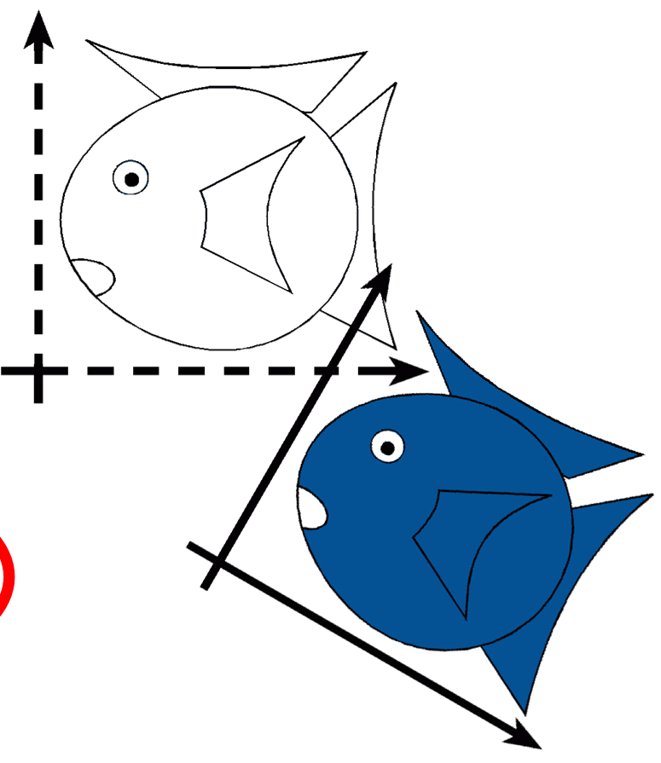
Rigid-Body / Euclidean Transforms
Preserves distances
Preserves angles
Rigid / Euclidean
Identity
Translation
Rotation

Slide 6
Similitudes / Similarity Transforms
Preserves angles
Similitudes
Rigid / Euclidean
Identity
Translation
Isotropic Scaling
Rotation

Slide 7
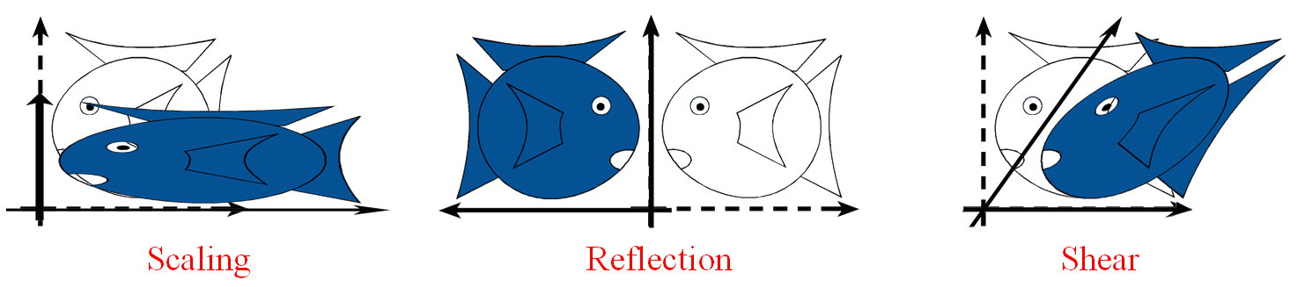
Linear Transformations
Similitudes
Linear
Rigid / Euclidean
Scaling
Identity
Translation
Isotropic Scaling
Reflection
Rotation
Shear

Slide 8
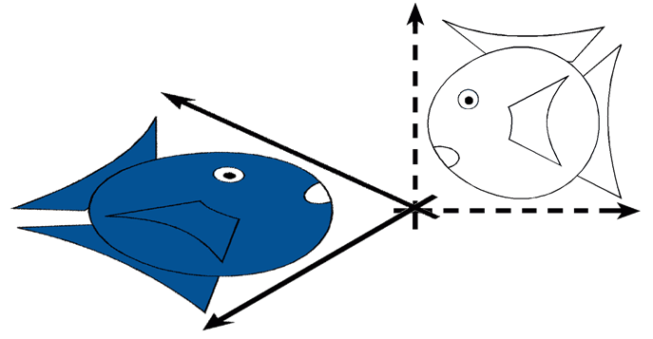
Linear Transformations
L(p + q) = L(p) + L(q)
L(ap) = a L(p)
Similitudes
Linear
Rigid / Euclidean
Scaling
Identity
Translation
Isotropic Scaling
Reflection
Rotation
Shear

Slide 9
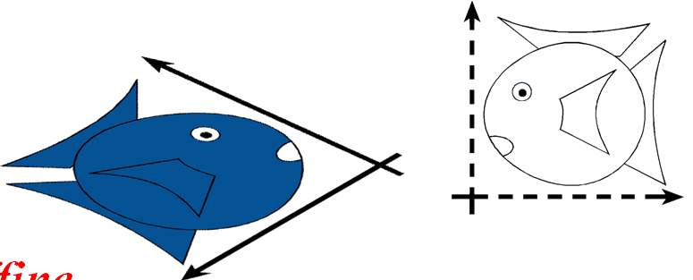
Affine Transformations
preserves parallel lines
Affine
Similitudes
Linear
Rigid / Euclidean
Scaling
Identity
Translation
Isotropic Scaling
Reflection
Rotation
Shear

Slide 10
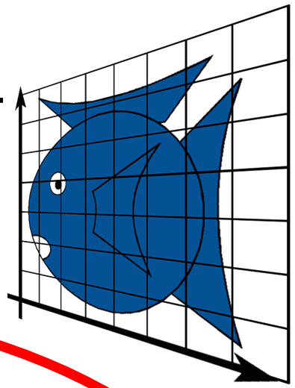
Projective Transformations
preserves lines
Projective
Affine
Similitudes
Linear
Rigid / Euclidean
Scaling
Identity
Translation
Isotropic Scaling
Reflection
Rotation
Shear
Perspective

Slide 11
How are Transforms Represented?
x' = ax + by + c
y' = dx + ey + f
x'
y'
a b
d e
x
y
c
f
=
+
p' = M p + t

Slide 12
Translation in homogenous coordinates
x' = ax + by + c
y' = dx + ey + f
Cartesian formulation
Homogeneous formulation
x'
y‘
1
a b
d e
0 0
c
f
1
x
y
1
x'
y'
a b
d e
x
y
c
f
=
=
+
p' = M p + t
p' = M p

Slide 13
Homogeneous Co-ordinates
Translation, scaling and rotation are expressed (non-homogeneously) as:
translation: P′ = P + T
Scale: P′ = S · P
Rotate: P′ = R · P
Composition is difficult to express, since translation not expressed as a matrix multiplication
Homogeneous coordinates allow all three to be expressed homogeneously, using multiplication by 3 × 3 matrices
W is 1 for affine transformations in graphics

Slide 14
Homogeneous Coordinates
Add an extra dimension
in 2D, we use 3 x 3 matrices
In 3D, we use 4 x 4 matrices
Each point has an extra value, w
x'
y'
z'
w'
a
e
i
m
b
f
j
n
c
g
k
o
d
h
l
p
x
y
z
w
=
p' = M p

Slide 15
Homogeneous Coordinates
Most of the time w = 1, and we can ignore it
If we multiply a homogeneous coordinate by an affine matrix, w is unchanged
x'
y'
z'
1
a
e
i
0
b
f
j
0
c
g
k
0
d
h
l
1
x
y
z
1
=

Slide 16
Mechanics of Rigid Transformations
Translate
Rotate
Scale

Slide 17
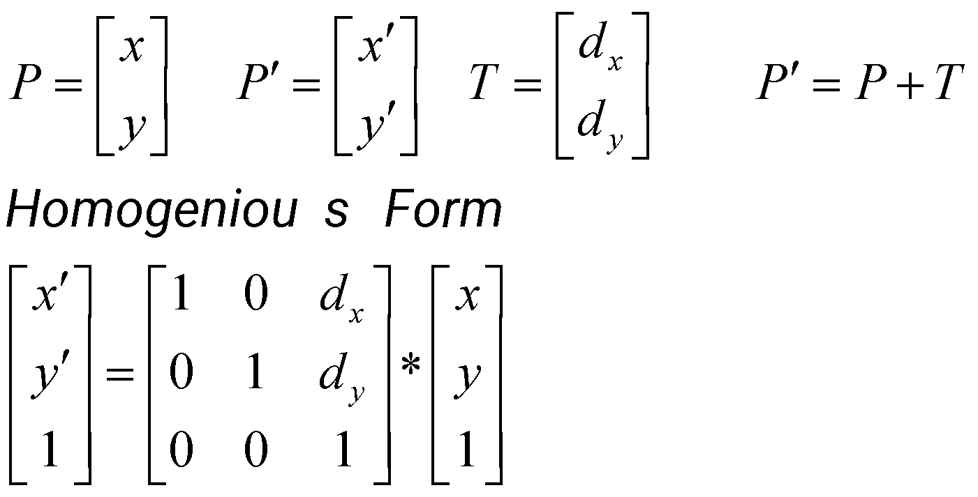
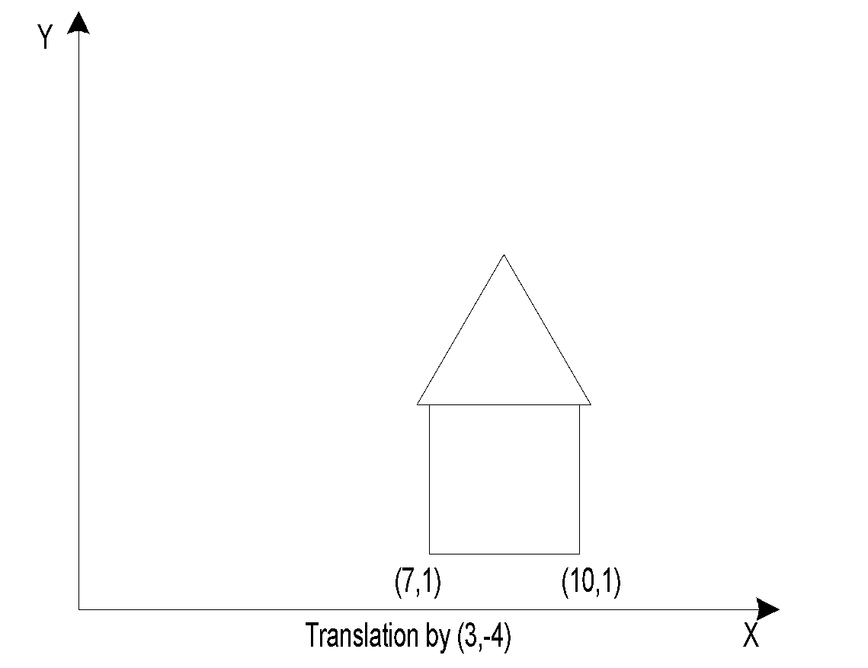
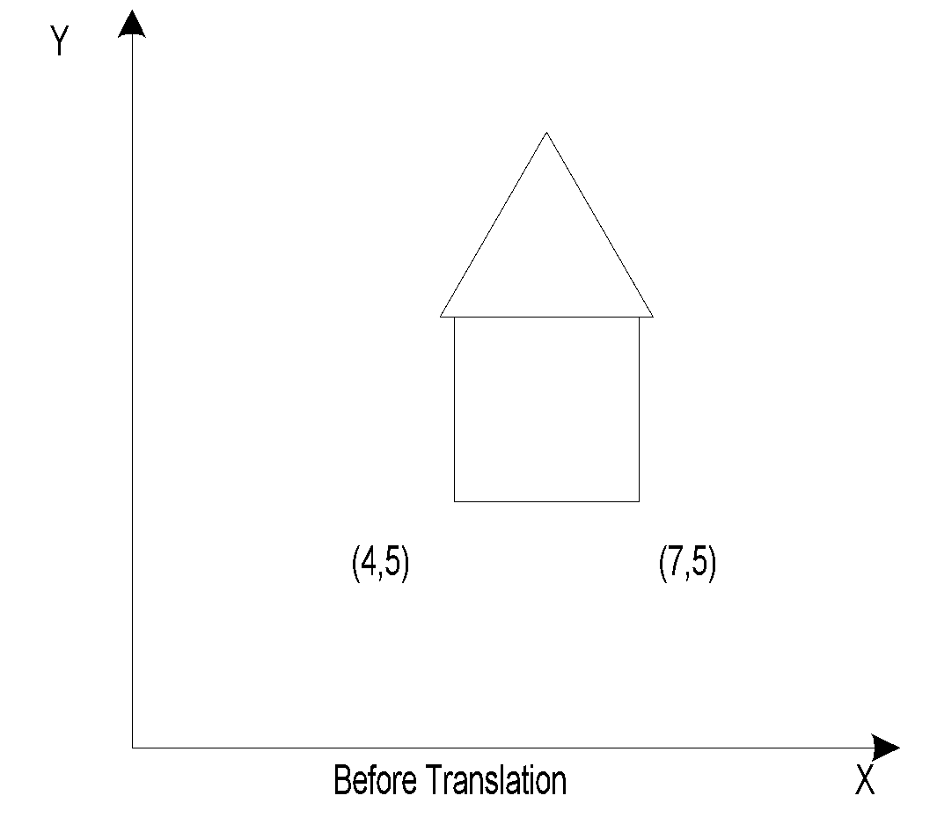
Translation – 2D
x’ = x + d_{x}
y’ = y + d_{y}

Slide 18
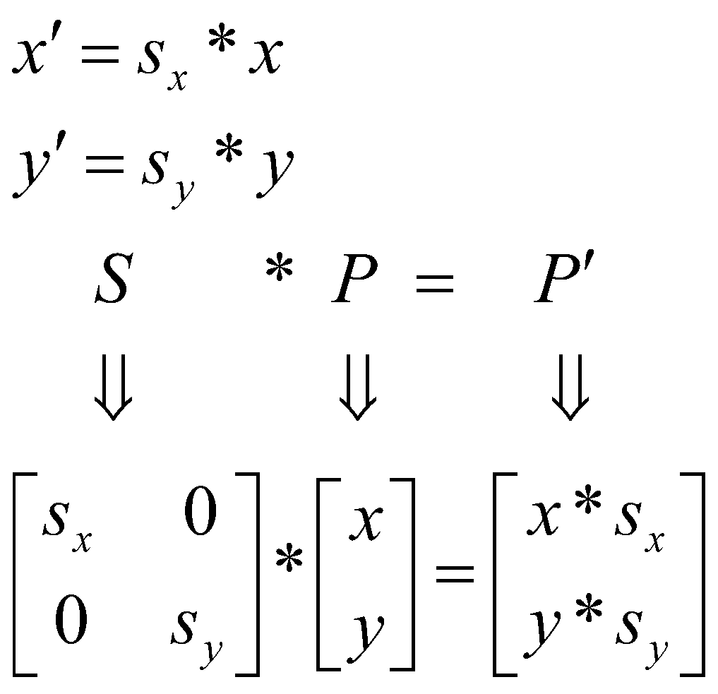
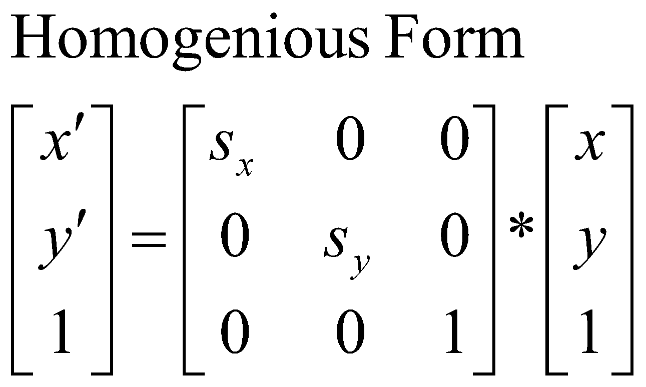
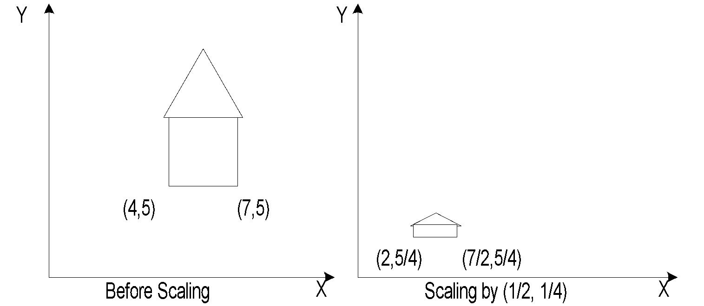
Scaling – 2D
Types of Scaling:
Differential ( s_{x} != s_{y} )
Uniform ( s_{x} = s_{y} )

Slide 19
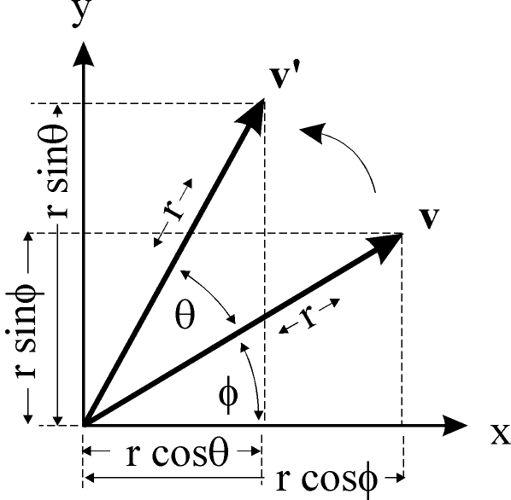
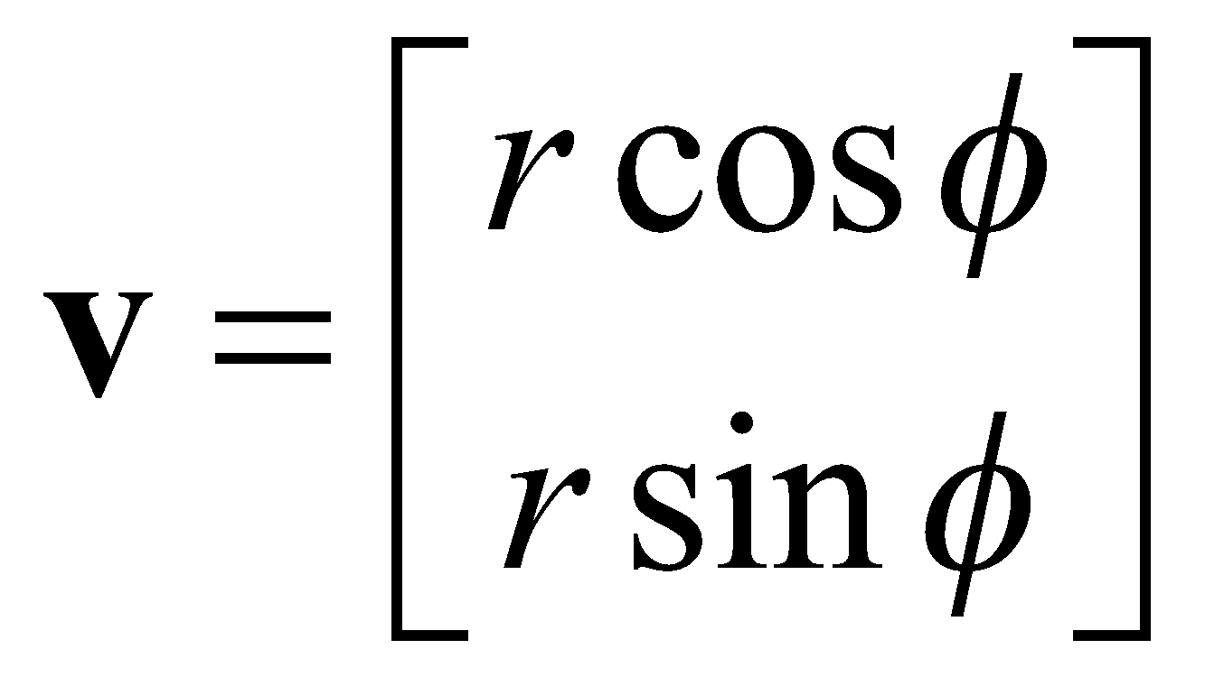
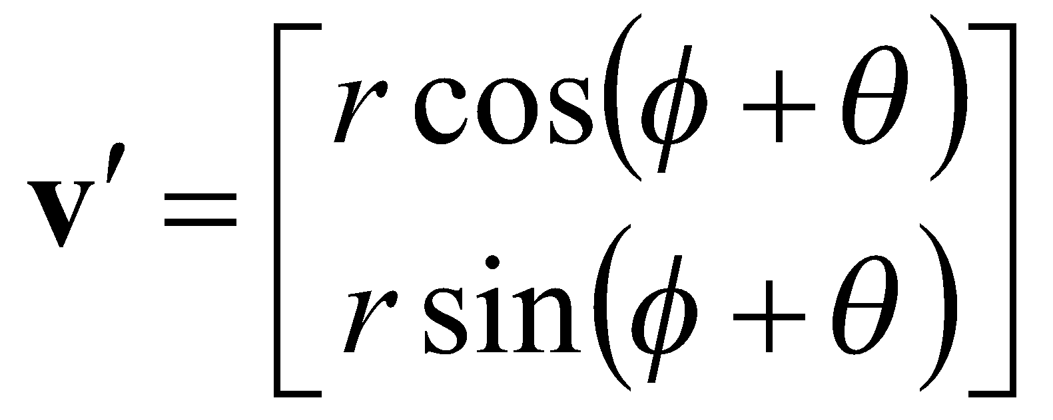
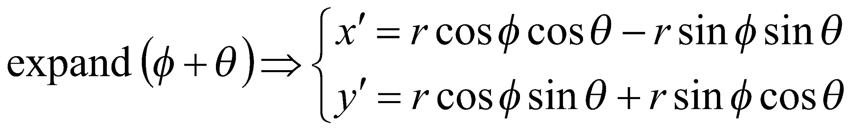
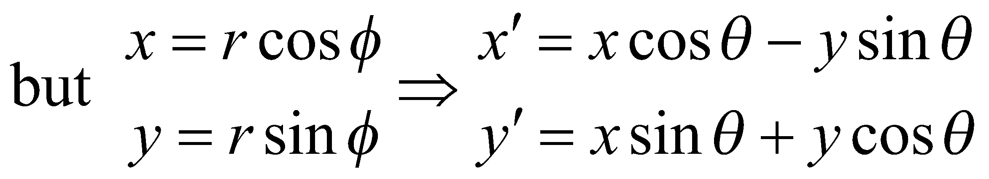
Rotation – 2D
rotated
original

Slide 20
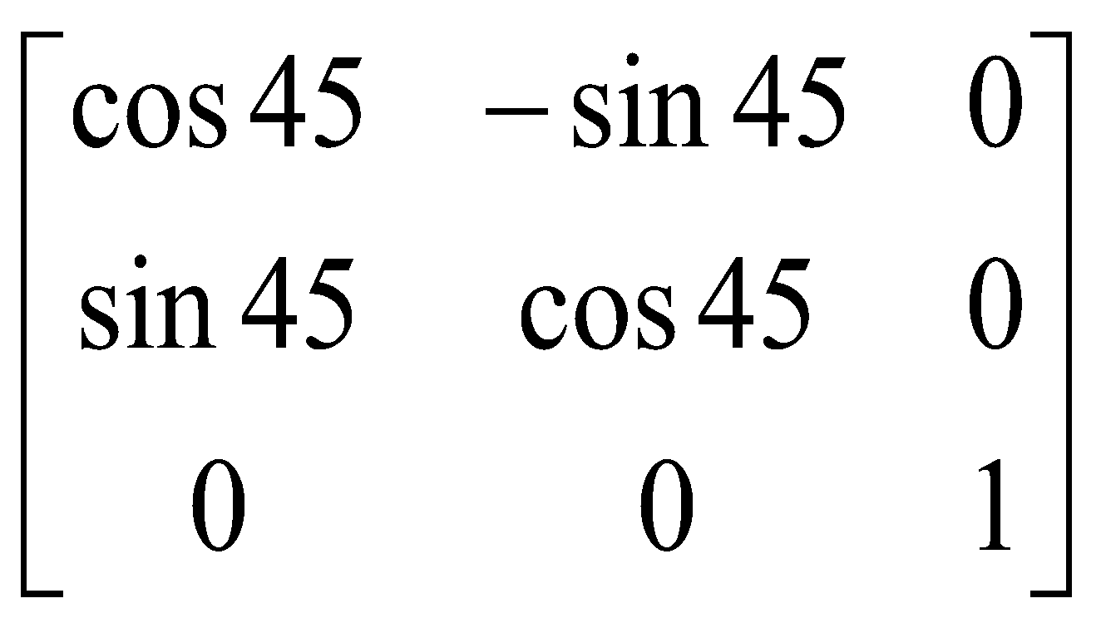
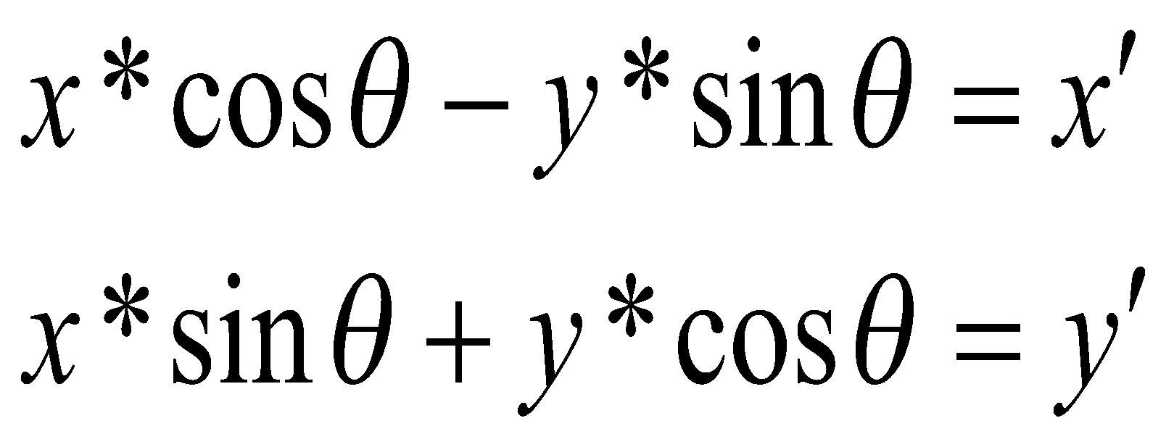
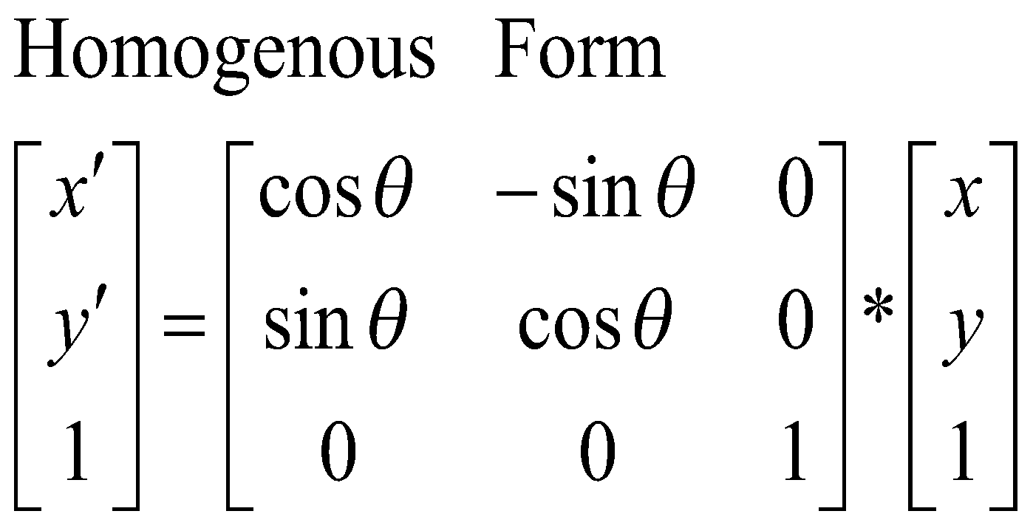
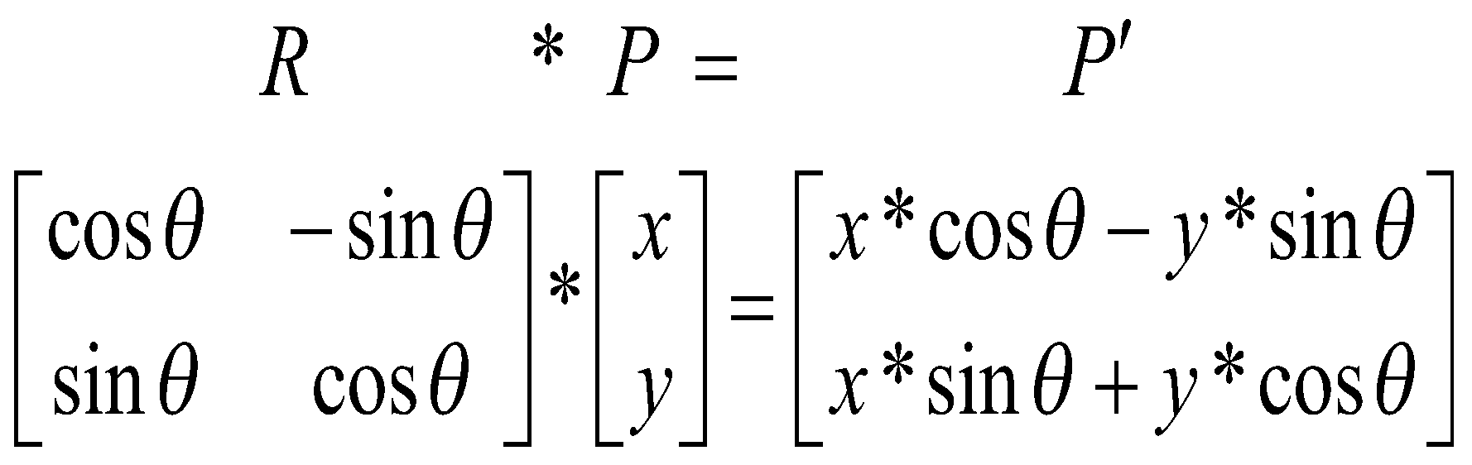
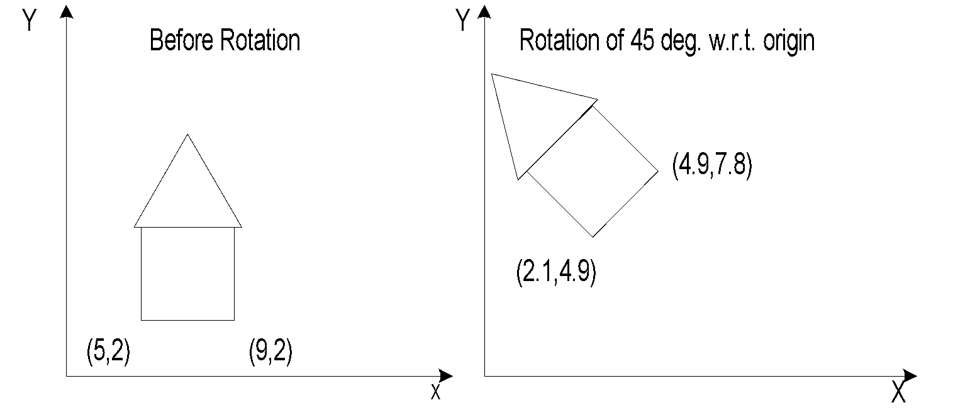
Rotation – 2D

Slide 21
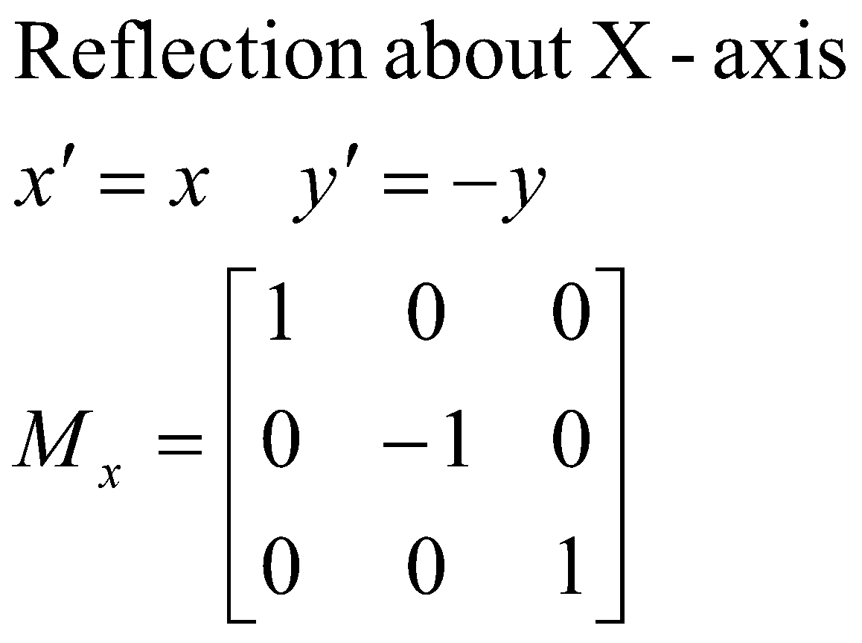
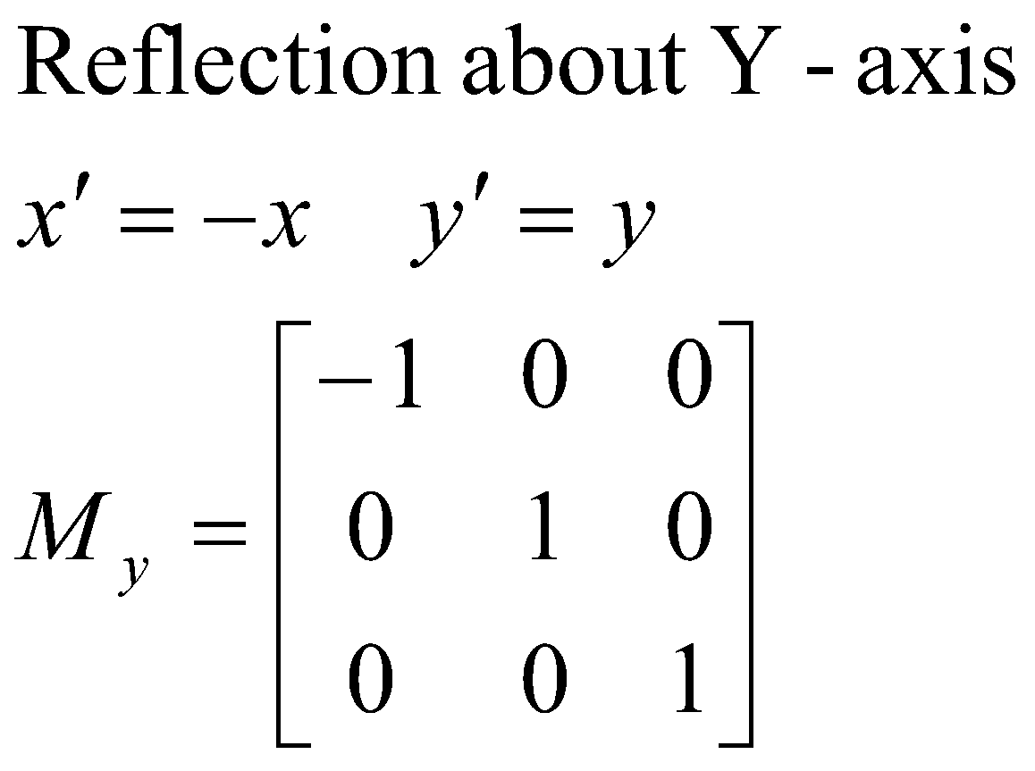
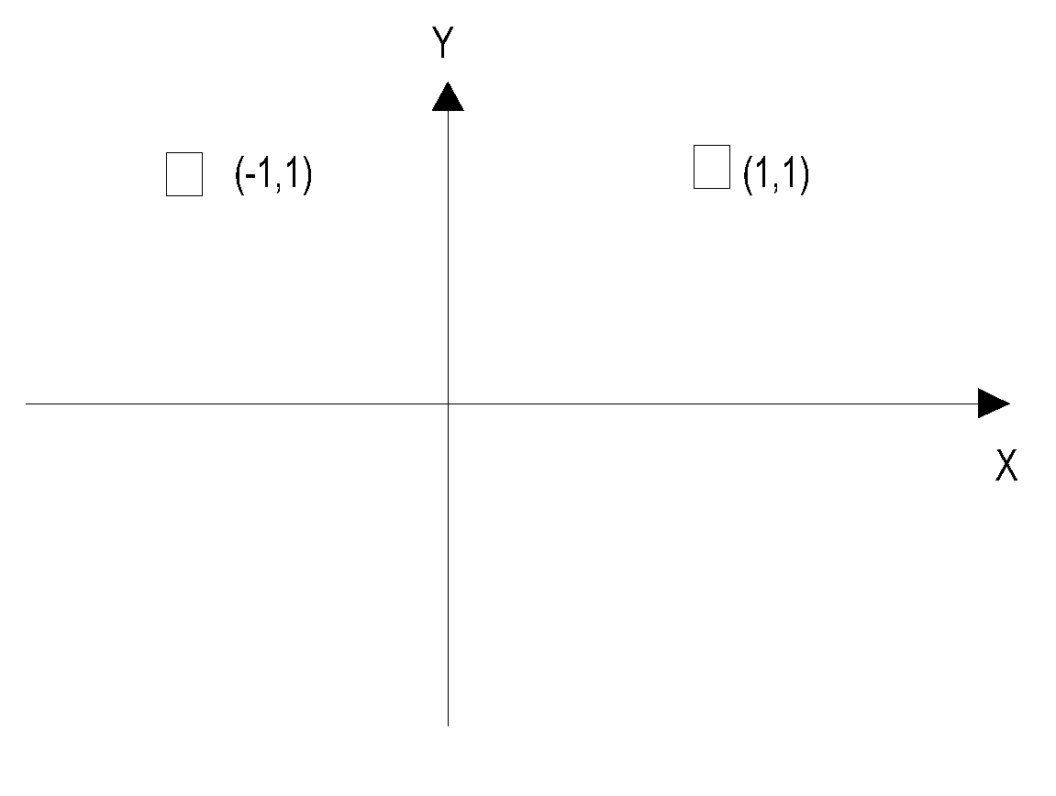
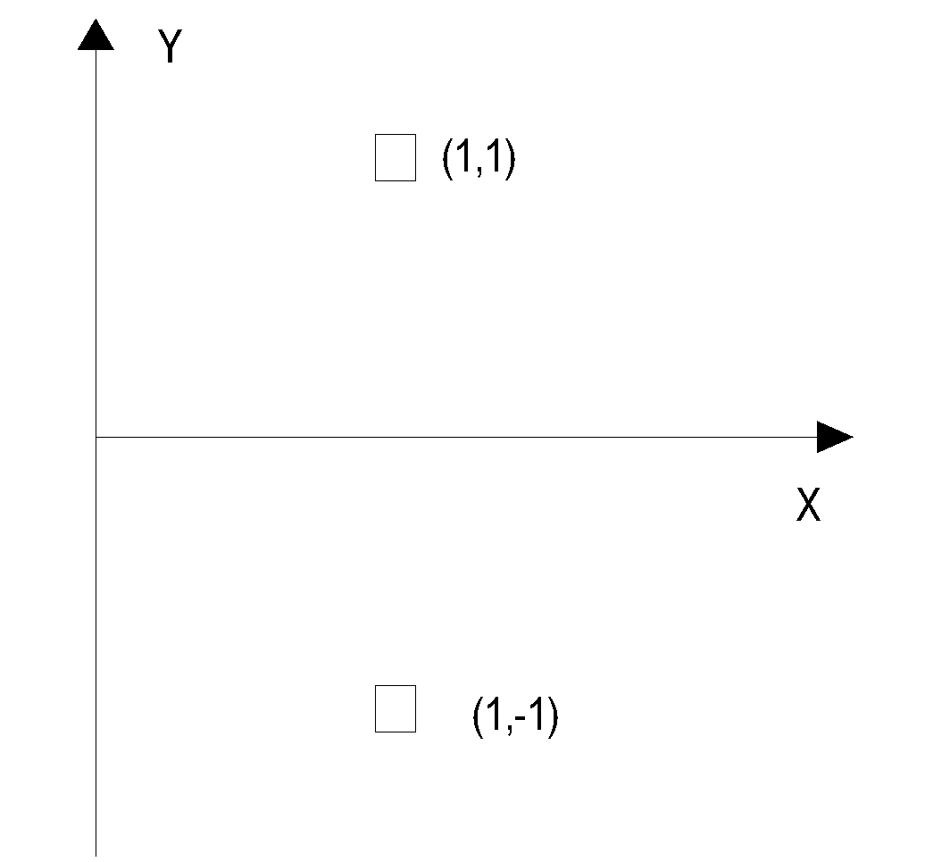
Mirror Reflection

Slide 22


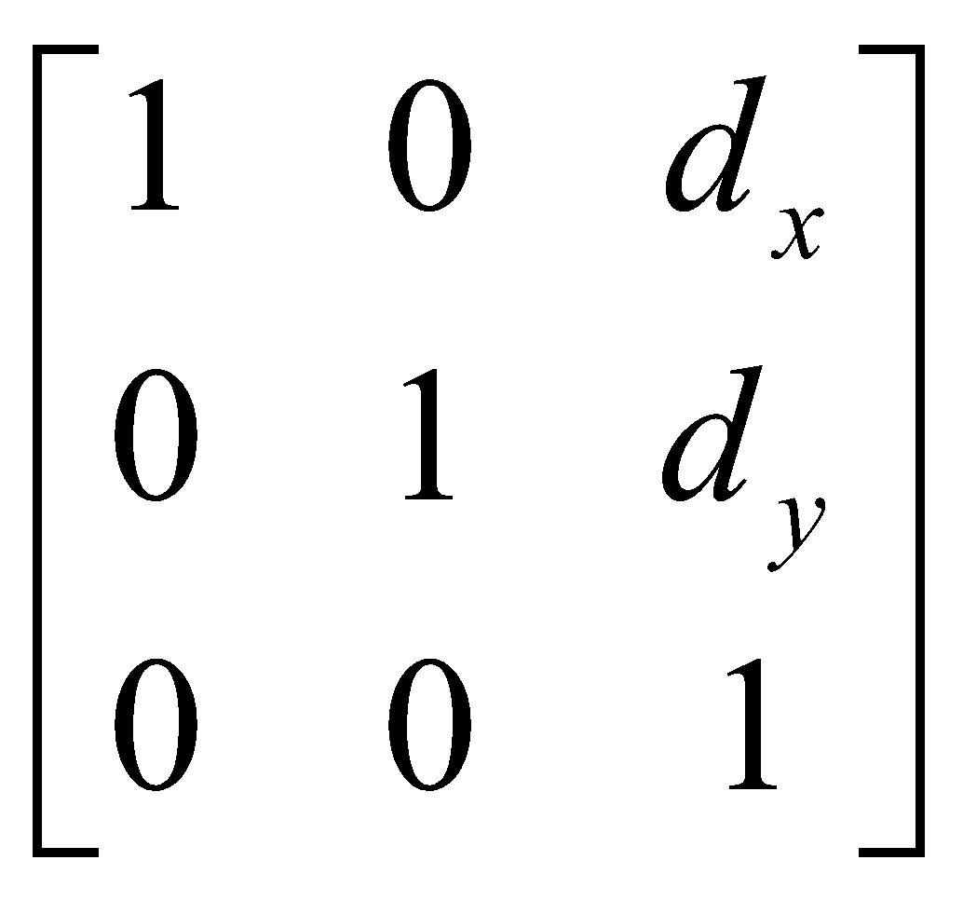
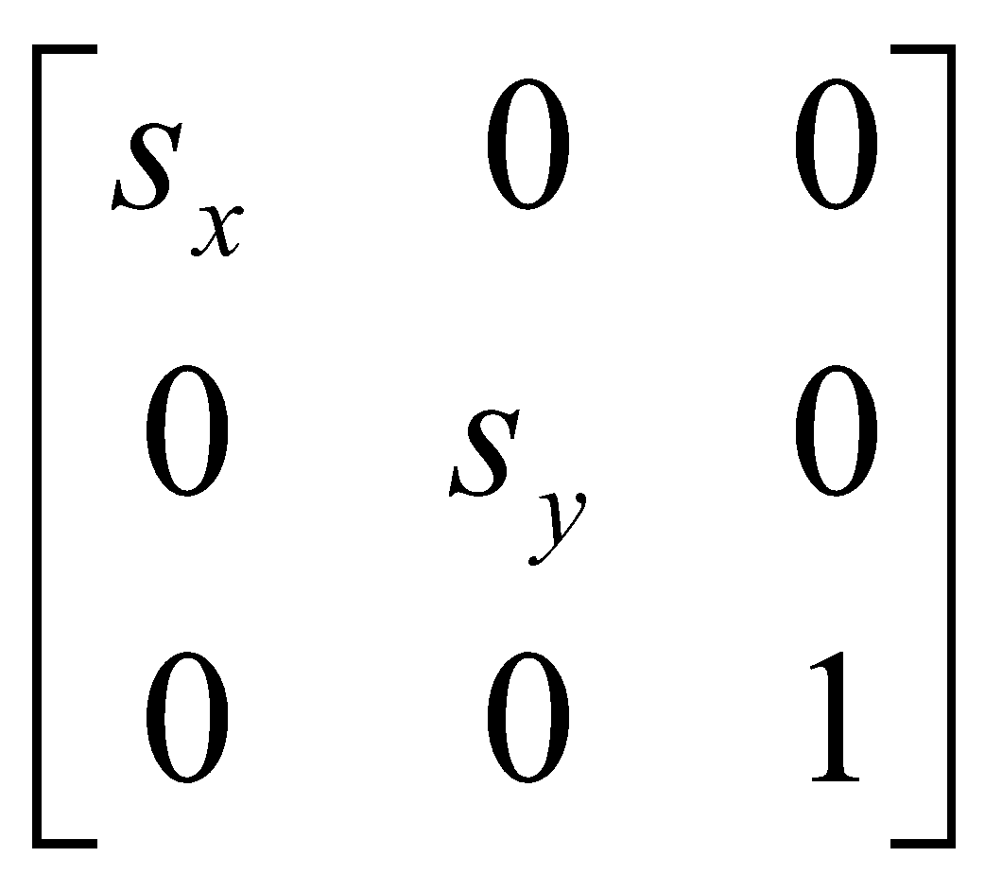



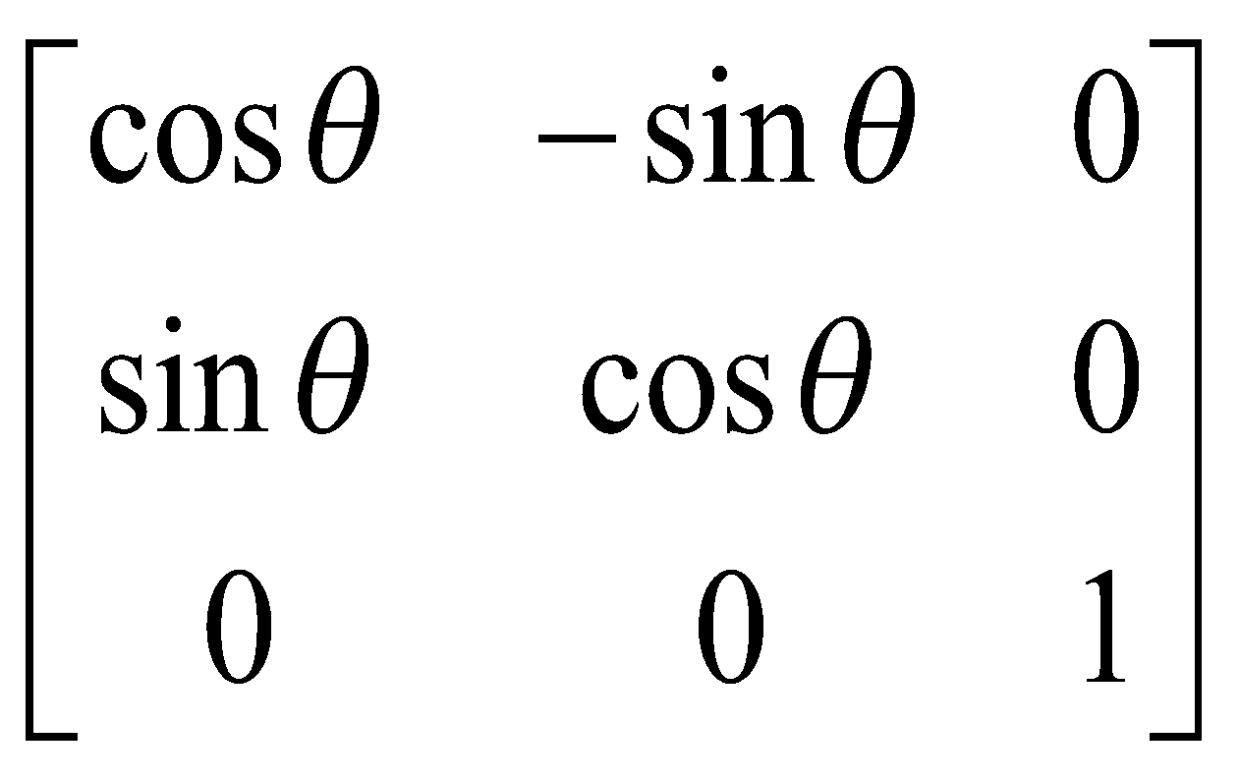
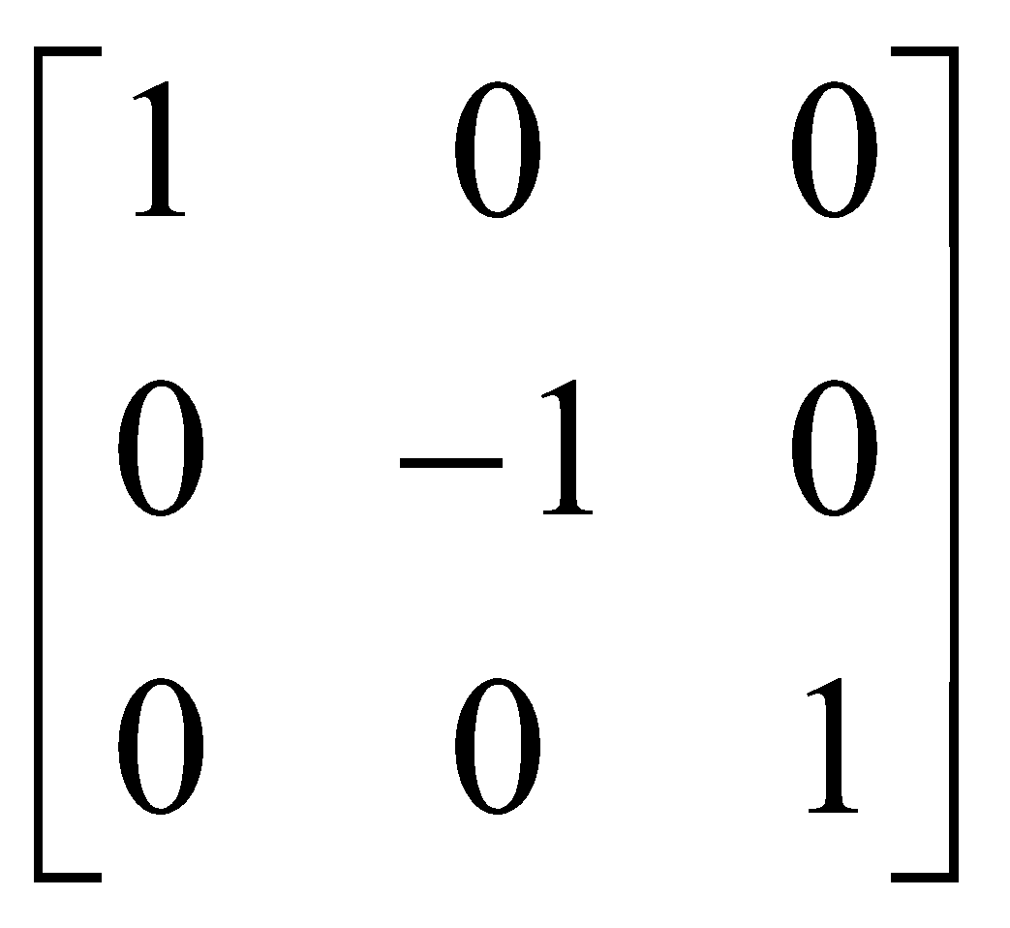
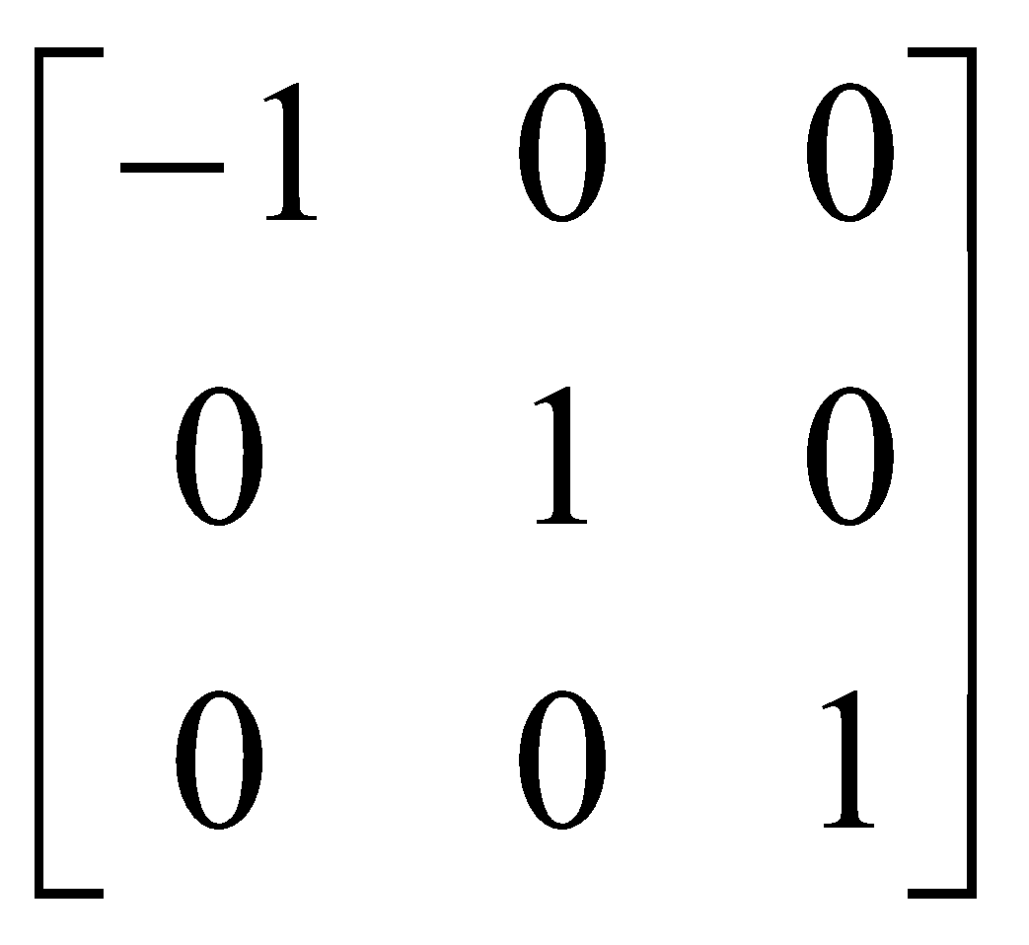

Slide 23
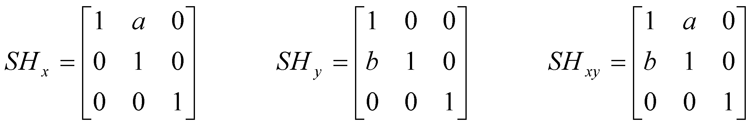
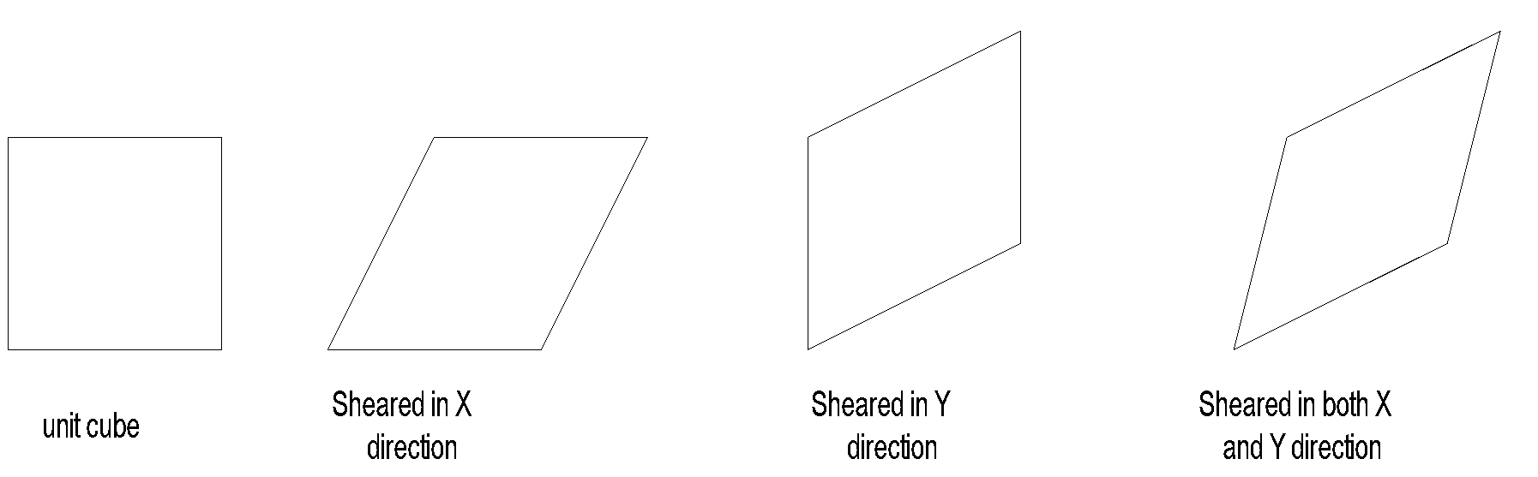
Shearing Transformation

Slide 24
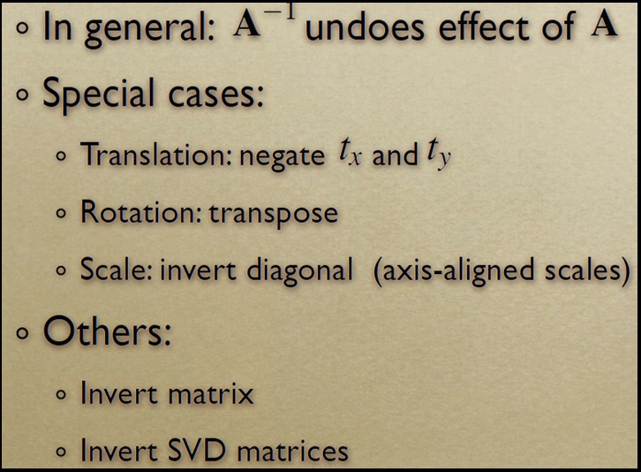
Inverse Transforms

Slide 25
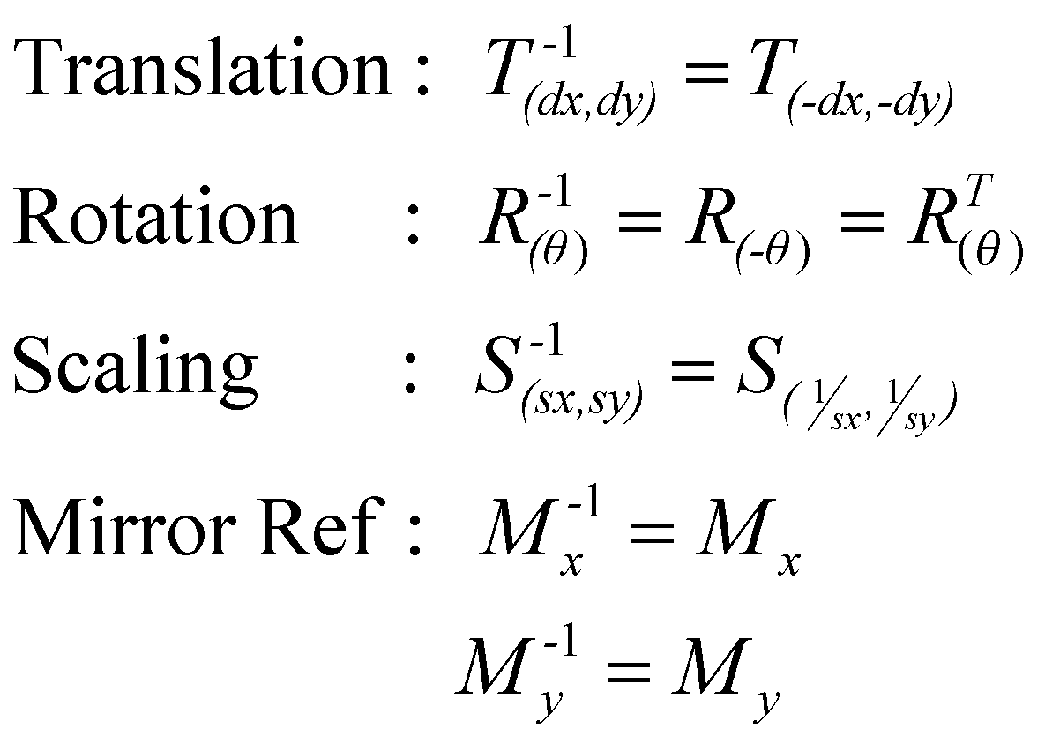
Inverse Transformations

Slide 26
Composing Transformations

Slide 27
How are transforms combined?
Scale then Translate
(5,3)
Scale(2,2)
(2,2)
Translate(3,1)
(1,1)
(3,1)
(0,0)
(0,0)
Use matrix multiplication: p' = T ( S p ) = TS p
0
0
1
0
2
0
2
1
0
0
1
0
0
1
0
0
1
3
1
2
0
0
0
2
0
3
1
TS =
=
Caution: matrix multiplication is NOT commutative!

Slide 28
Non-commutative Composition
Scale then Translate: p' = T ( S p ) = TS p
(5,3)
Scale(2,2)
(2,2)
Translate(3,1)
(1,1)
(3,1)
(0,0)
(0,0)
Translate then Scale: p' = S ( T p ) = ST p
(8,4)
Translate(3,1)
(4,2)
Scale(2,2)
(6,2)
(1,1)
(3,1)
(0,0)

Slide 29
Non-commutative Composition
Scale then Translate: p' = T ( S p ) = TS p
1
0
0
0
1
0
3
1
1
2
0
0
0
2
0
0
0
1
2
0
0
0
2
0
3
1
1
TS =
=
Translate then Scale: p' = S ( T p ) = ST p
0
0
1
2
0
0
2
0
0
1
0
0
1
3
1
2
0
0
2
6
2
0
0
1
0
0
1
ST =
=

Slide 30
Combining Translations, Rotations
Order matters!! TR is not the same as RT (demo)
General form for rigid body transforms
We show rotation first, then translation (commonly used to position objects) on next slide. Slide after that works it out the other way

Slide 31
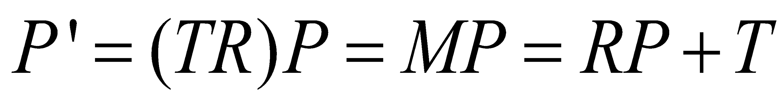
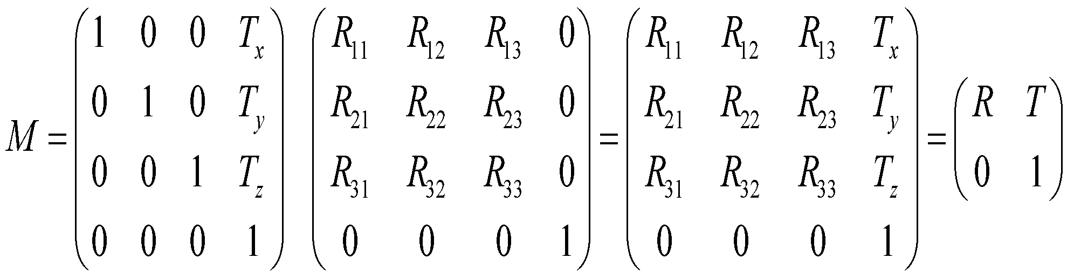
Rotate then Translate

Slide 32
Example Composite Transforms
2D Case

Slide 33
Rotate clockwise 90 with respect to P
P(h,k)
P(h,k)
If we only apply Rotate(-90)
P(h,k)

Slide 34
Translate
(-h,-k)
P(h,k)
P’(0,0)
Rotate
(-90)
Translate
(h,k)
P(h,k)

Slide 35
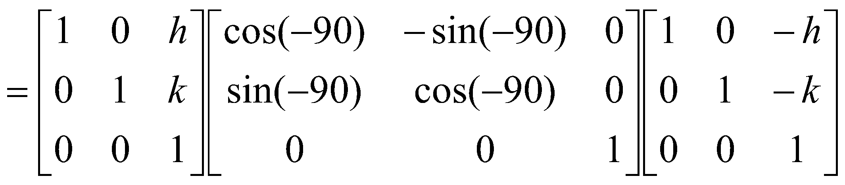

Slide 36
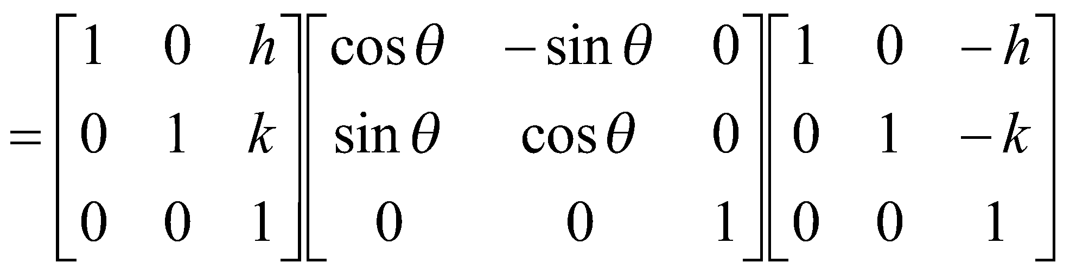

Slide 37
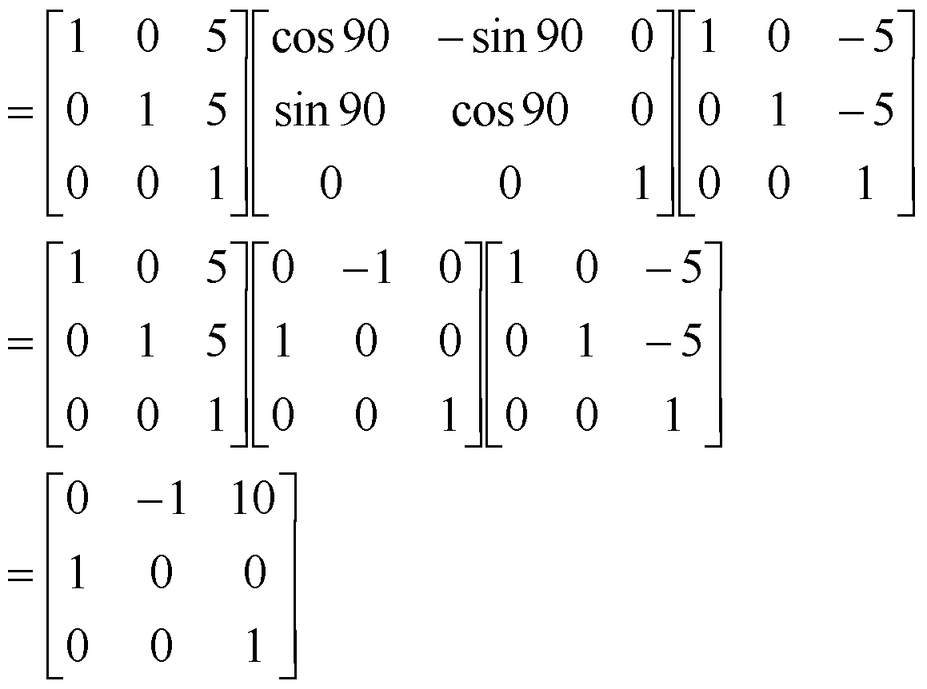
Suppose, a composite transformation is defined as rotating 90 degree counterclockwise with respect to point (5, 5). Calculate the composite transformation matrix in homogenous form. Then, find the new coordinates of the point (10, 10) after transformation.

Slide 38

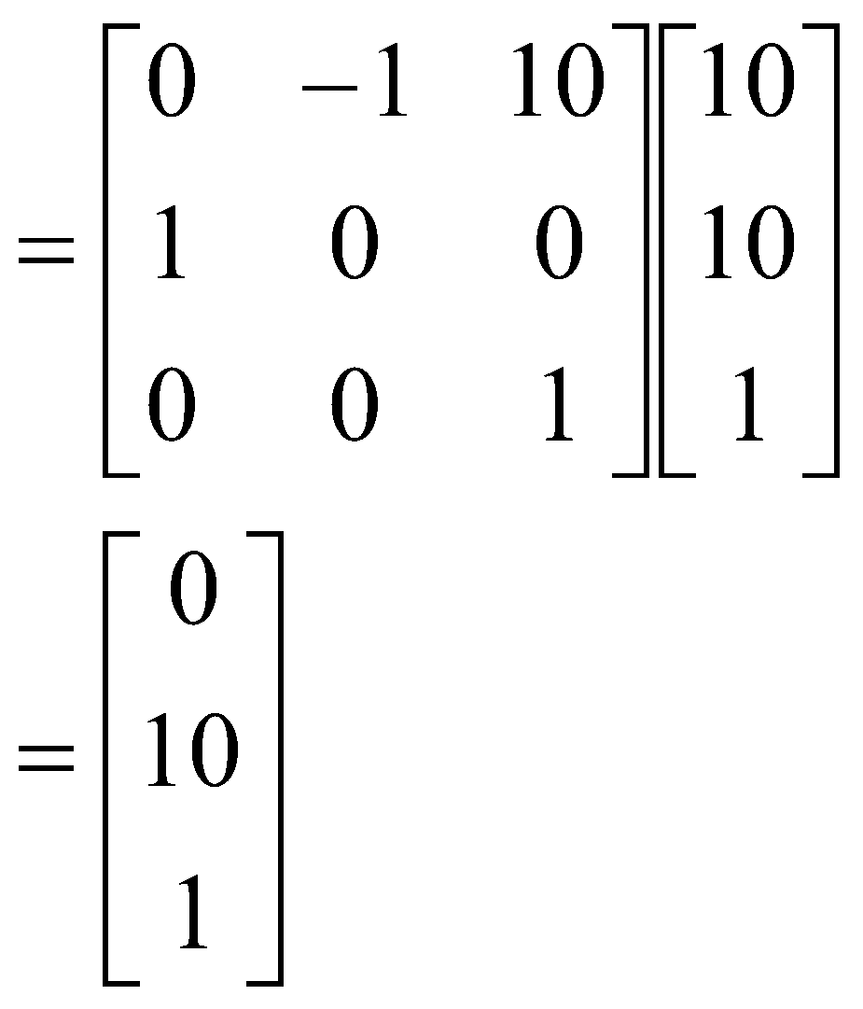
Suppose, a composite transformation is defined as rotating 90 degree counterclockwise with respect to point (5, 5). Calculate the composite transformation matrix in homogenous form. Then, find the new coordinates of the point (10, 10) after transformation.
So, the new coordinate of P is (0, 10)

Slide 39
Isotropic scale by 1.5 with respect to P(h,k)
P(h,k)
P(h,k)
If we only apply Scale(1.5, 1.5)
P(h,k)

Slide 40
Translate
(-h,-k)
P(h,k)
P’(0,0)
Scale(1.5, 1.5)
Translate
(h,k)
P(h,k)

Slide 41
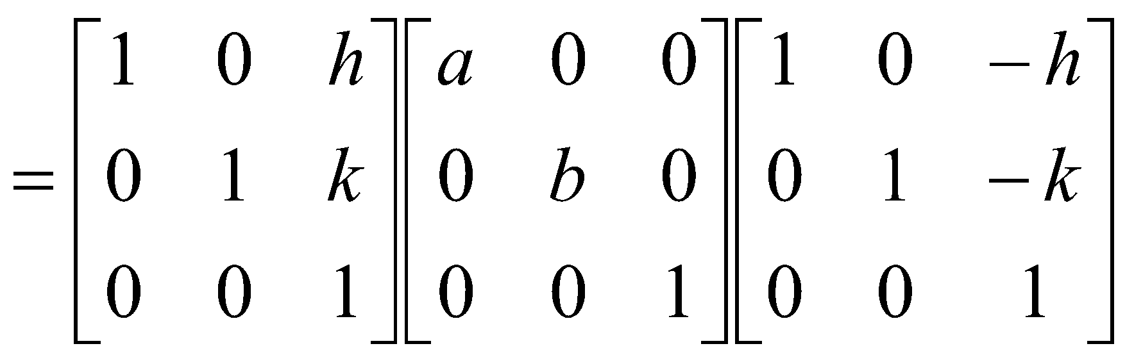

Slide 42
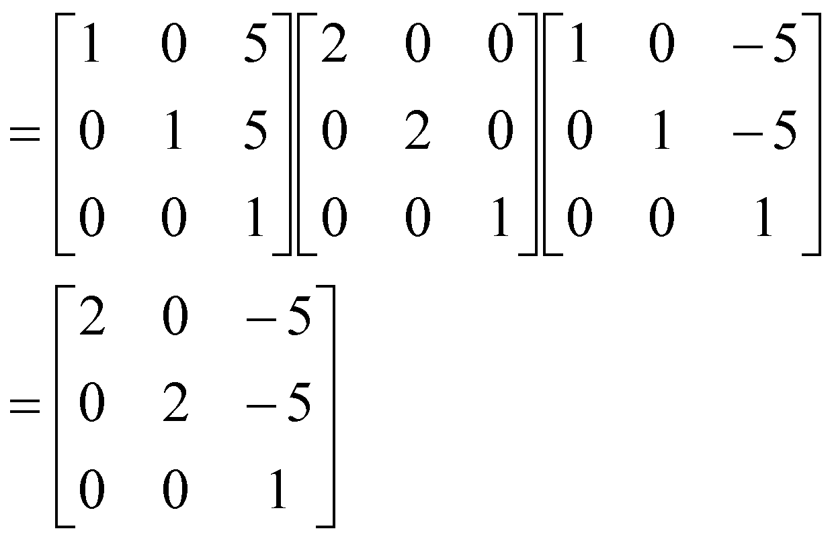
Suppose, a composite transformation is defined as scaling 2 times in both axis with respect to point (5, 5). Calculate the composite transformation matrix in homogenous form. Then, find the new coordinates of the point (10, 10) after transformation.

Slide 43
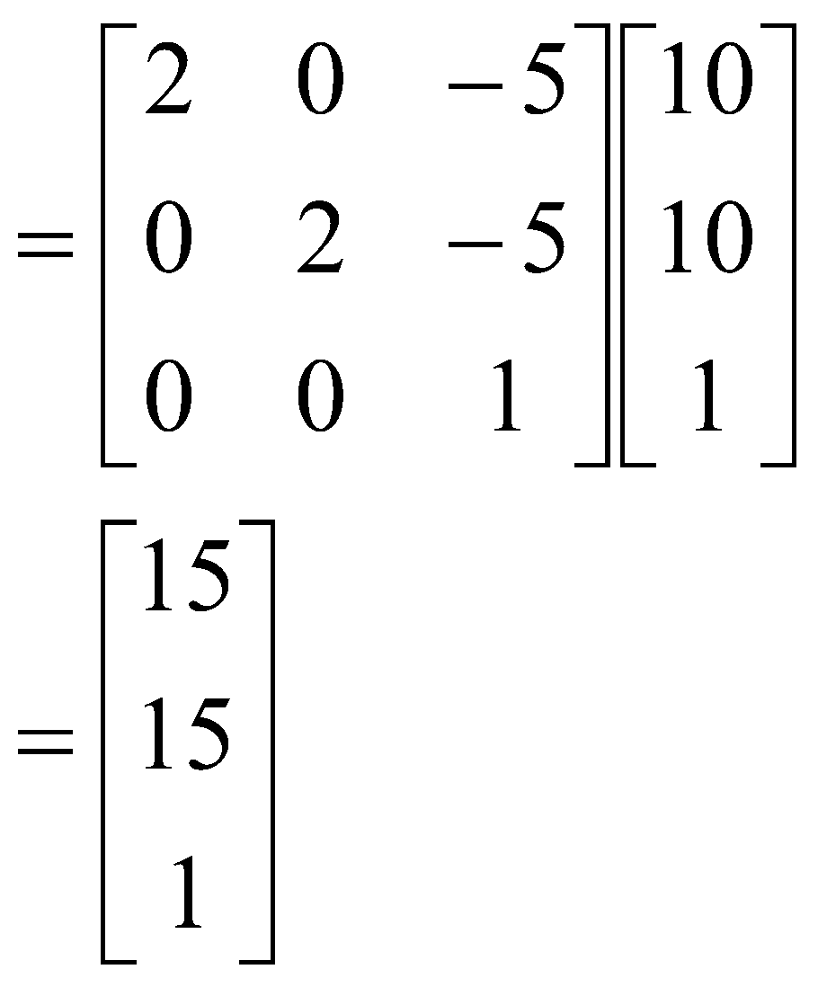
Suppose, a composite transformation is defined as scaling 2 times in both axis with respect to point (5, 5). Calculate the composite transformation matrix in homogenous form. Then, find the new coordinates of the point (10, 10) after transformation.
So, the new coordinate of P is (15, 15)

Slide 44
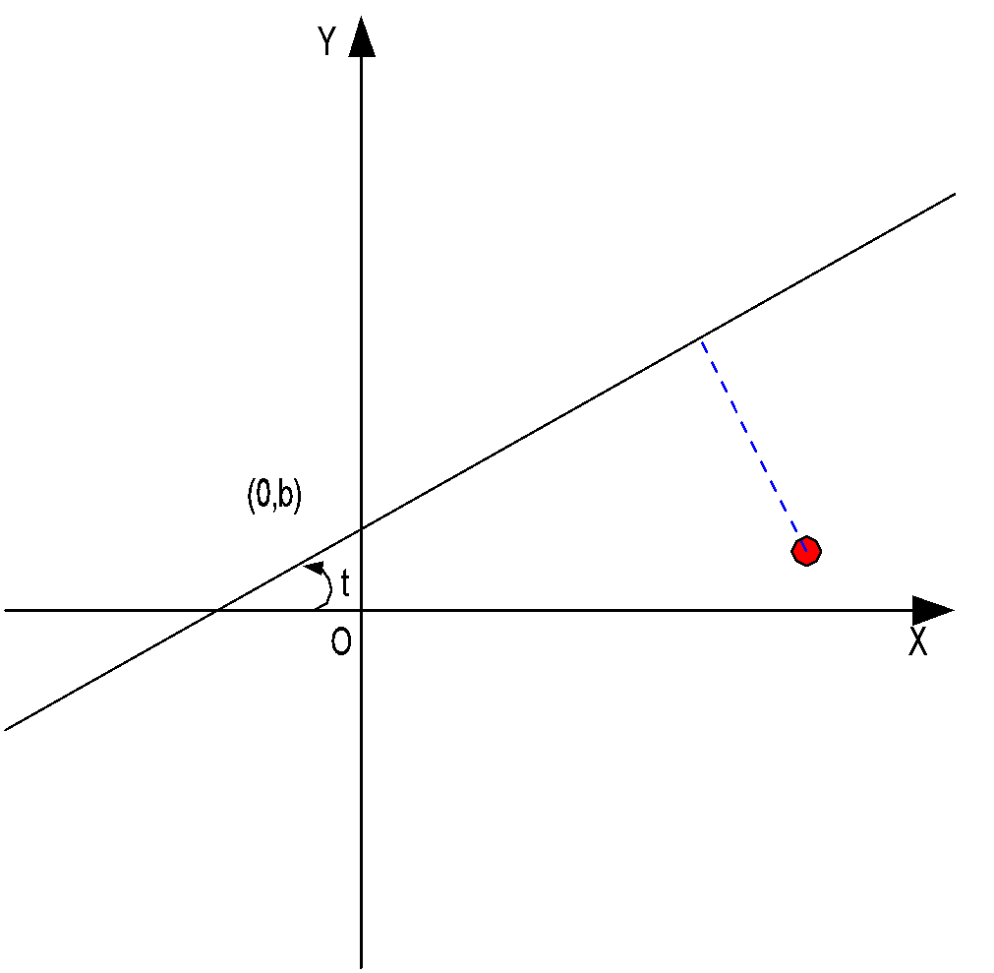
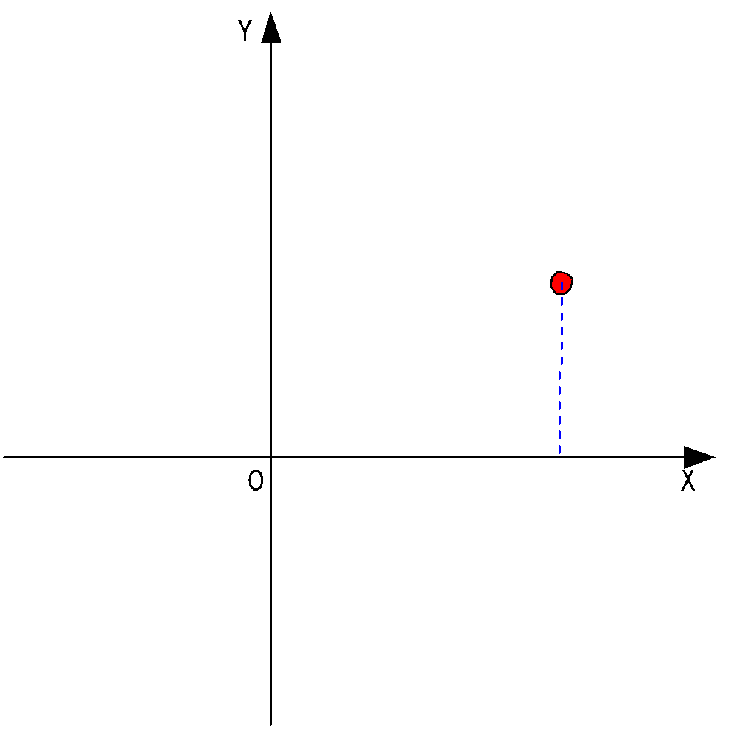
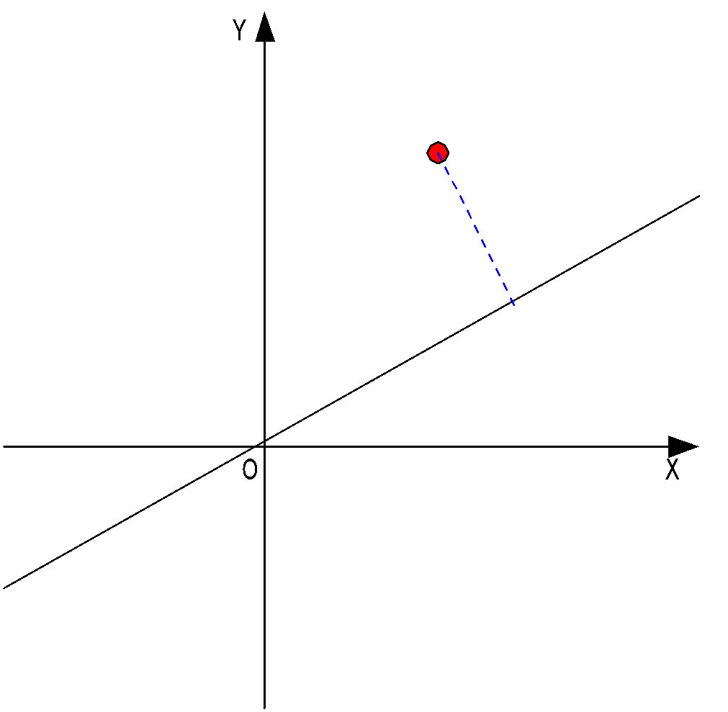
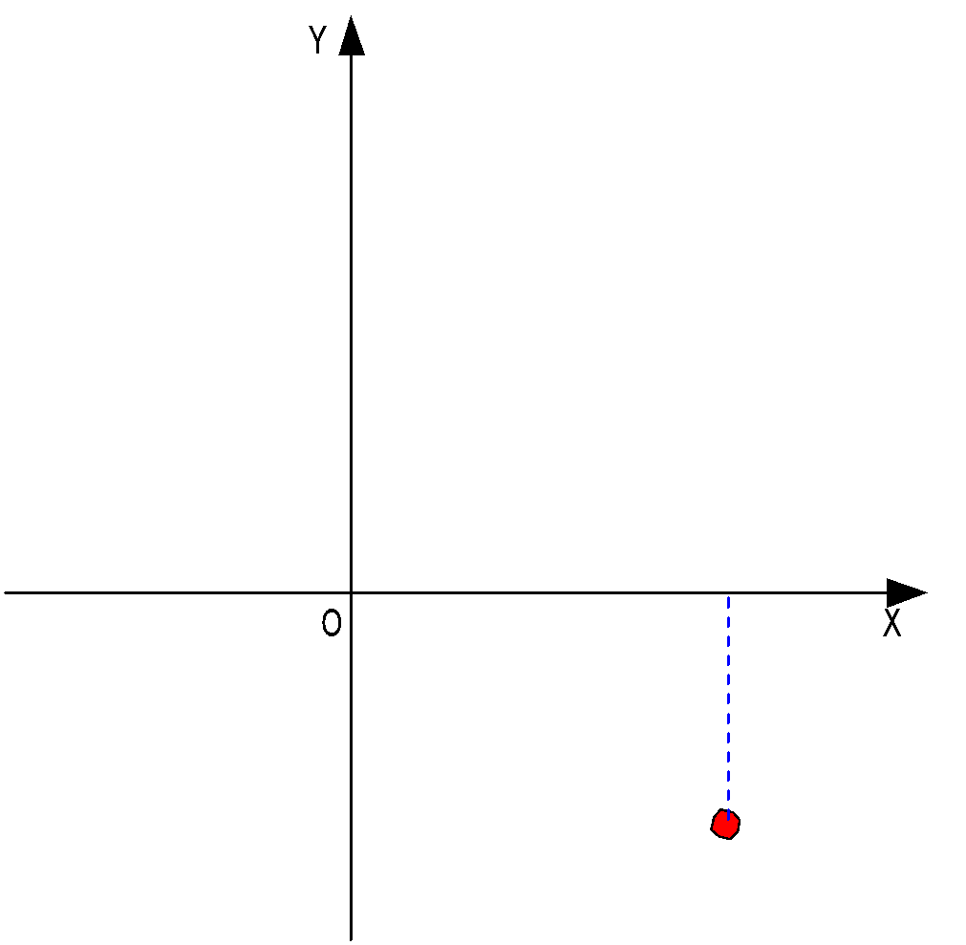


Reflection about line L, M_{L}
P(x,y)
Rotate(-θ)
Translate(0,-b)
Reflect(x axis)
Translate(0,b)
Rotate(θ)

Slide 45
Reflection about line L, M_{L}
Step 1: Translate (0,b) to origin
Step 2: Rotate -θ degrees
Step 3: Mirror reflect about X-axis
Step 4: Rotate θ degrees
Step 5: Translate origin to (0,b)
M_{L} =
T(0 ,b) *
R(θ) *
M _{x}*
R(-θ) *
T(0 ,-b)

Slide 46



Reflect the point (10, 5) with respect to the line y=x+2.
New coordinate (3, 12)

